Slide 1
Security Hub Automated Remediations Workshop
David Filiatrault
Principal Security Transformation Consultant
AWS Professional Services

Slide 2
Problem statement
Notes:
Given that context, lets look at why we built AWS Security Hub. There are really 4 problems that we are addressing.
Compliance is critical for many AWS users that face a myriad of internal and external compliance requirements as they migrate to the cloud. Compliance can also help ensure that accounts and resources are properly configured which is a top painporint for many users.
AWS (and non-AWS) users are typically using dozens of different security tools. They all have different data formats that need to be parsed and normalized before they can be analyzed. Large organizations can spend 1000s of hours on this.
AWS users may face a handful to tens of thousands of alerts per day depending on what tools they are using and how their environment is configured. This can be too much for a human to handle
Lastly, customers want the coveted single pane of glass that brings together both their compliance and security information across all of their accounts into a single view.

Slide 3
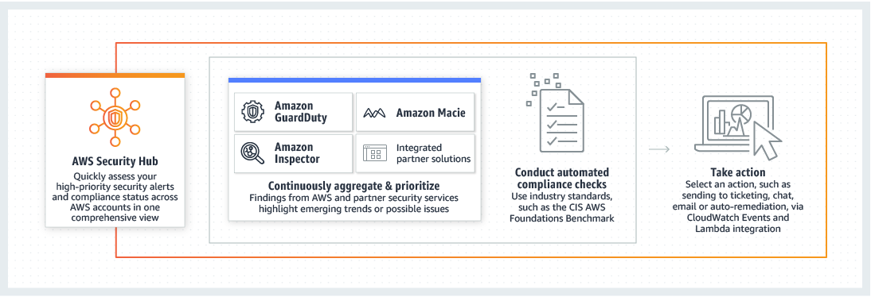
AWS Security Hub overview
Notes:
Get started in a few clicks and a few more for multi-account rollup
No normalization or parsing needed with AWS Finding Format
29 partner integrations with simple setup (a few clicks to 15 min of CloudFormation deployment); 3 fully automated AWS integrations
25+ out-of-the-box AWS correlation and stacking rules called “insights” and ability for customers to create their own; plus default ones from partners coming soon.
Automated compliance checks via CIS AWS Foundations Benchmark
Automated response and remediation actions on specific findings via CloudWatch Events rules and targets

Slide 4





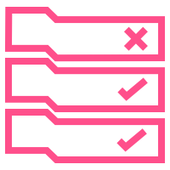


Customizable response and remediation actions
Event
Amazon CloudWatch
Lambda function
or
Custom Remediation
AWS Security Hub
Automation document
or
Rule
All findings automatically send to CloudWatch events, and
Security Hub user can select findings in the console and take a custom action on them. These findings are sent to CloudWatch decorated with a custom action ID
AWS Step Function
5. The target could be things like a chat, ticketing, on-call management, SOAR platform, or custom remediation playbook, for example a set of filters and actions in a Cloud Custodian Policy
3. User creates Amazon CloudWatch Events rules to look for certain findings associated with a custom action ID or findings with specific characteristics.
4. The rule defines a target, typically a Lambda function, Step Function, or Automation document
Notes:
1. Added Cloud Custodian logo and text to 5. “… for example a set of filters and actions in a Cloud Custodian Policy”

Slide 5








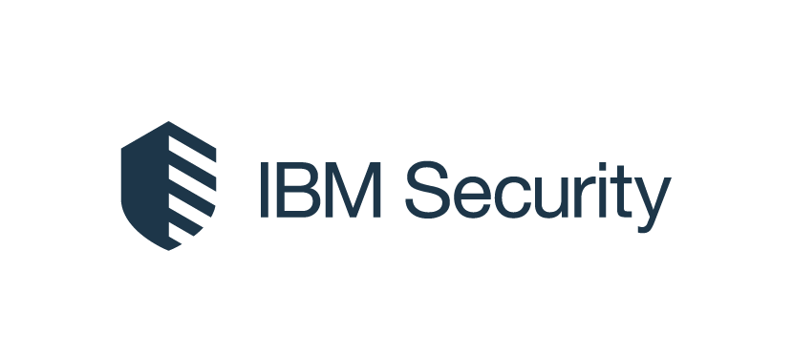

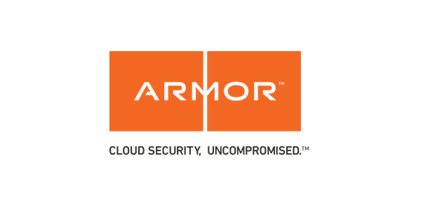


Partner integrations
Forwarding findings into AWS Security Hub
“Taking Action”
Firewalls
Vulnerability
Endpoint
AWS
Security Hub
Amazon
CloudWatch
Events
Compliance
MSSP
Other
Event
(event-
based)

Slide 6
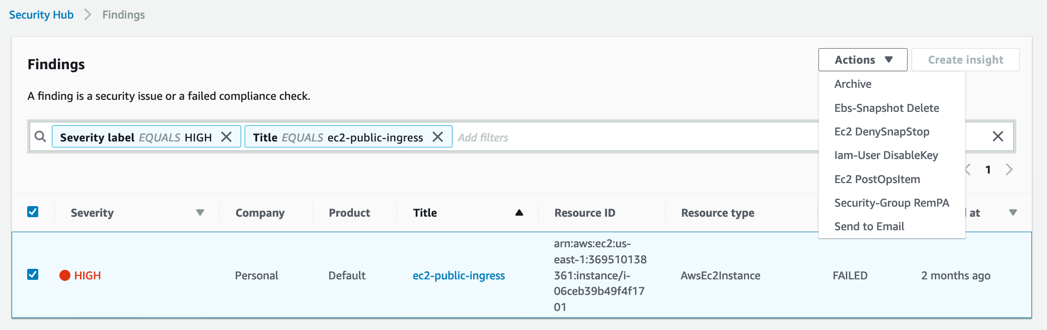


Custom Actions on Findings
Notes:
The blue box shows examples of custom actions I’ve created
They can be invoked by selecting one of more findings, then clicking the desired Action.

Slide 7
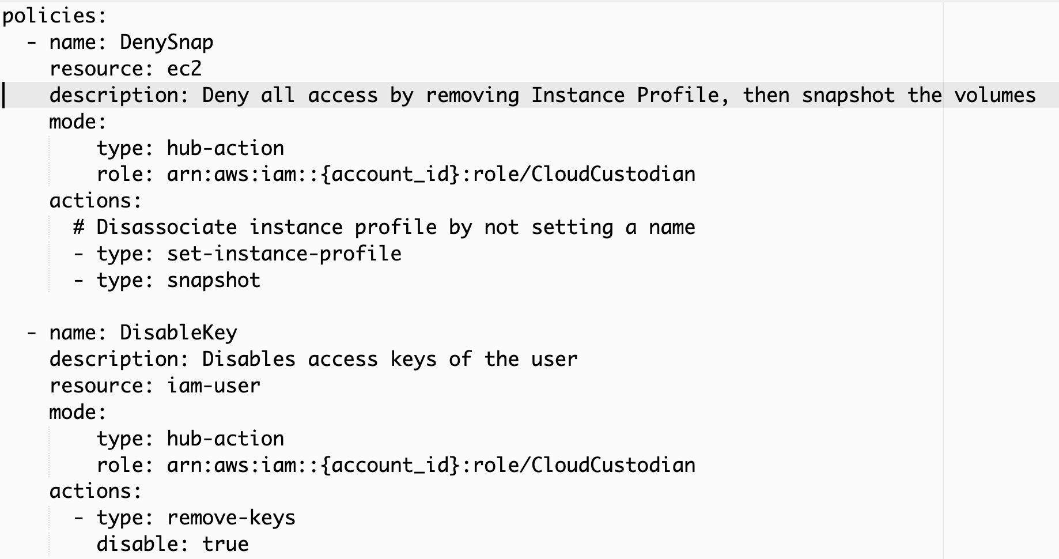
Custom Actions: How to create using Cloud Custodian
Notes:
While the Custom Actions can be coded with any of the ways supported by the target types for Cloudwatch events, this screenshot shows you how easy it can be using Cloud Custodian.
1) The first policy named “DenySnapStop”, works on ec2 instances, and will dissociate it’s IamInstanceProfile, Snapshot it’s volumes

Slide 8
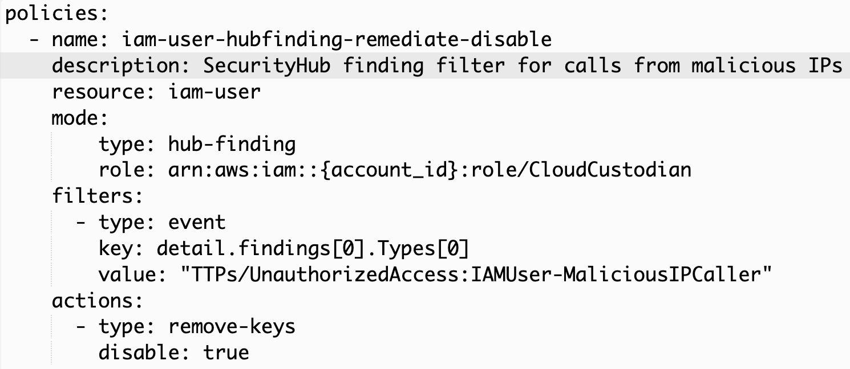
Security Hub generated CW Events with Automated Remediation by Cloud Custodian

Slide 9
Workshop Details
Browse to https://dashboard.eventengine.run or http://bit.ly/2r9lNg2
Enter the 12 digit hash code given to you
Click the green “Proceed” button
When the User Dashboard page appears, click on the “AWS Console” button.
On the “AWS Console Login” popup window, click “Open AWS Console” which opens up a new browser tab into a AWS account for you to use for this workshop.
Note, All data and resources in this account will be deleted at the end of the workshop.
Open a new browser window/tab to follow the directions at http://bit.ly/2NENDZT which links to https://github.com/FireballDWF/securityhub-remediations/blob/master/docs/index.md
Read the page down, skip over the Presentation deck link.
Open the first module as a new tab. Repeat for each module, stop after #6

Slide 10
Questions?

